Slide 1
Introduction to Machine Learning

Slide 2
Introduction
Machine learning models are computer programs that are used to recognize patterns in data or make predictions.
Machine learning is a subset of artificial intelligence (AI) that focuses on building systems that learn from data and make decisions or predictions without being explicitly programmed for every task.
Instead of writing specific rules or algorithms for every task, machine learning
models are trained on data and improve their performance based on experience.

Slide 3
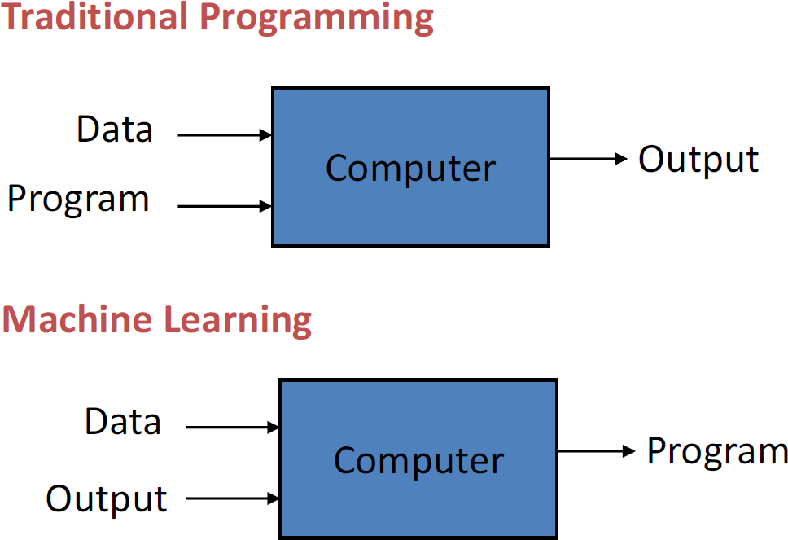
Machine Learning (ML)
“A computer program is said to learn from experience (E) with some class of tasks
(T) and a performance measure (P) if its performance at tasks in T as measured by P
improves with E”

Slide 4
Why is ML needed?
Traditional programming is rule based
Programs implement rules, computers follow them exactly.
Problem: Many real world problems do not have clear rules. E.g. What rules can be defined to recognize a face?
Explosion of data
Massive amount of data is generated – social media, online transactions, sensors and IoT devices.
Traditional programming is not capable of processing and extracting insights from the huge amount of data.
ML systems improve with experience
Traditional programs remain the same unless reprogrammed.
ML algorithms improve, adapt and update themselves with experience.

Slide 5
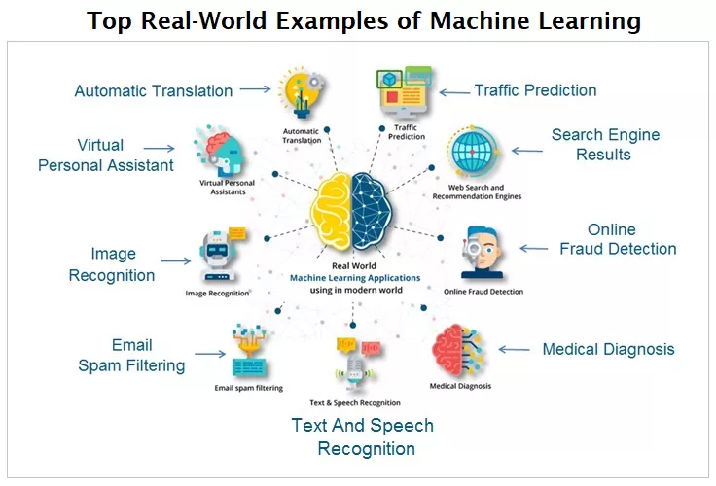
Applications

Slide 6
Types
Supervised Learning
Unsupervised Learning
Semi supervised learning
Reinforcement Learning

Slide 7
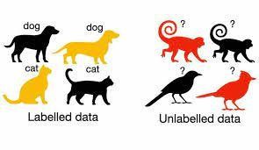
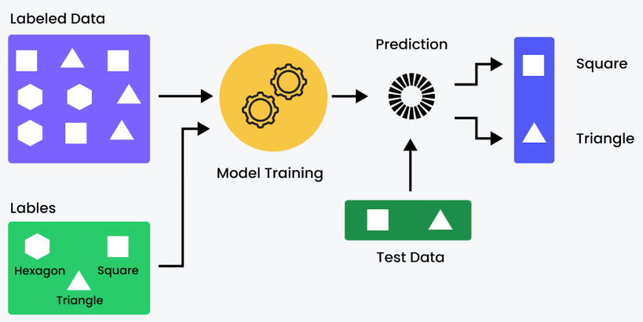
Supervised Learning
Training data is labelled containing both descriptions(input) and the target(output).
training data (input, target)
input – description of a face, area of a house
target – happy, price of the house
The algorithm (model) tries to determine the relationship between the input and the output.
This knowledge is then used to predict the output for previously unseen inputs.

Slide 8
Supervised Learning: Types
Regression
the model predicts a continuous output.
E.g. predicting house prices based on features like size, number of bedrooms, and location.
Classification
the model assigns data points to predefined classes.
E.g., classifying emails as spam or not spam.
Algorithms: Linear regression, decision trees, support vector machine

Slide 9
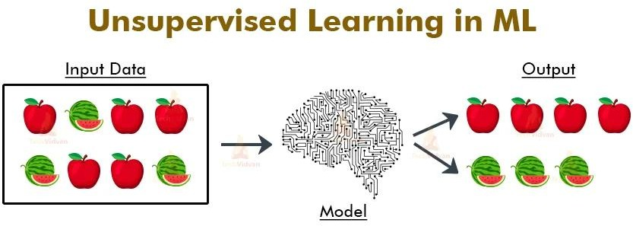
Unsupervised Learning
Algorithm is trained on unlabeled data to discover patterns within the data.
No predefined target outputs or labels.
Example: customer segmentation,

Slide 10
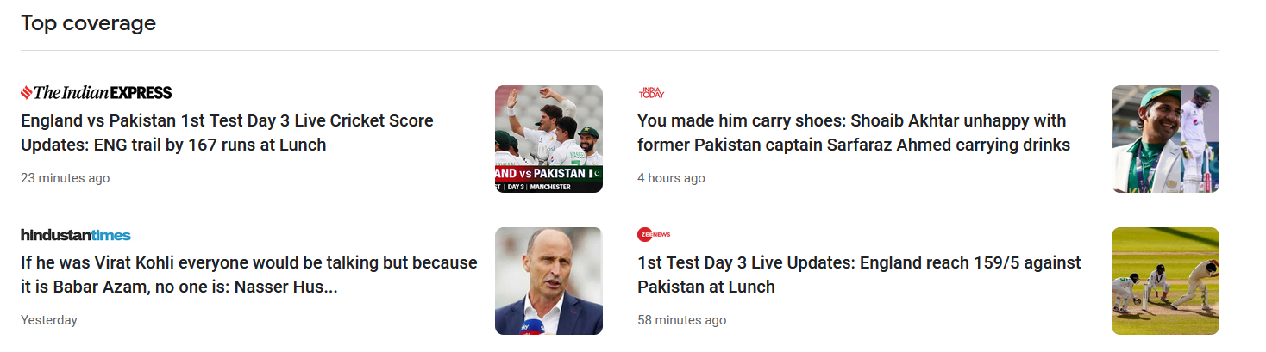
Unsupervised Learning

Slide 11
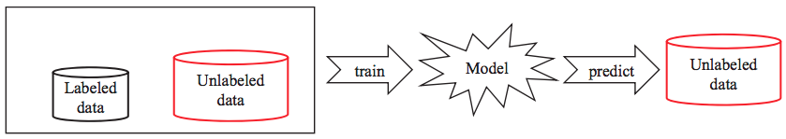
Semi-Supervised Learning
Combines a small amount of labeled data with a large amount of unlabeled data during training.

Slide 12
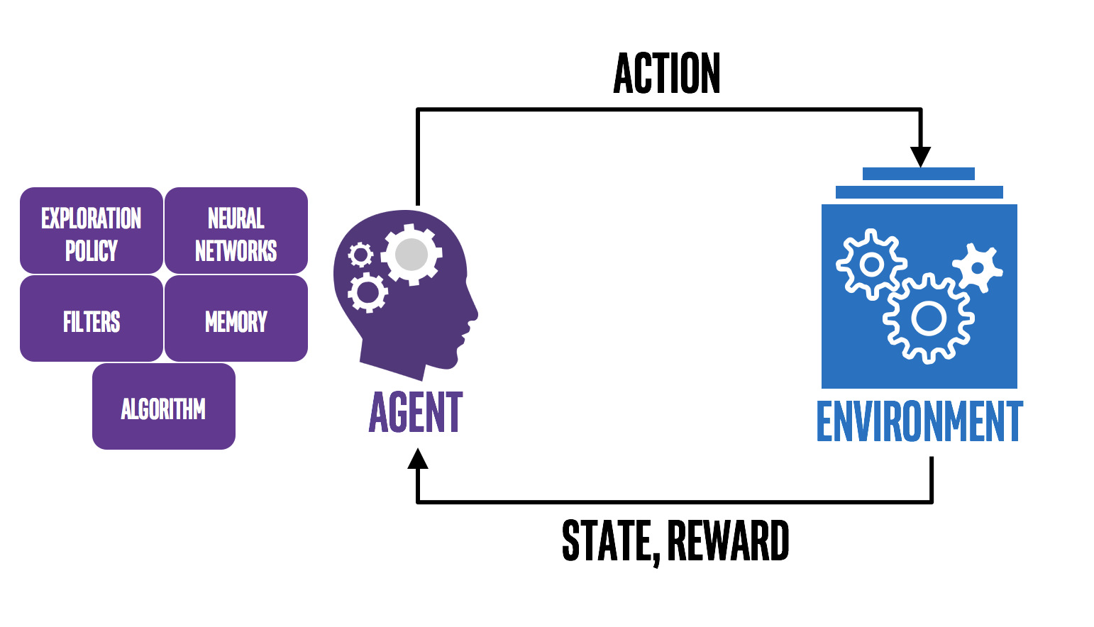
Reinforcement Learning
It is the training of machine learning models to make a sequence of decisions.
The computer employs trial and error to come up with a solution to the problem.
The agent gets either rewards or penalises for the actions it performs.

Slide 13
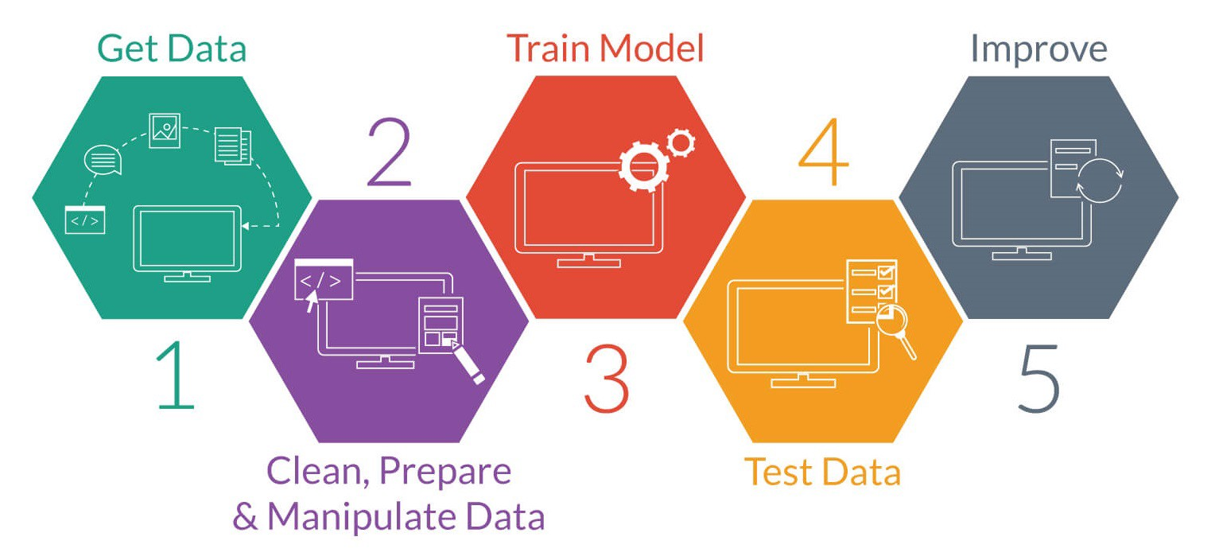
Basic ML workflow
Data collection
Data preprocessing
Feature selection
Model training
Evaluation
Prediction / Deployment

Slide 14
Data Preprocessing
Cleaning, transforming and performing other such operations on the data so that it can be effectively used by ML algorithms.
Why is it necessary?
Real-world data is often incomplete, noisy, and inconsistent.
Proper/processed data improves model accuracy, reduces training time, prevents misleading patterns, ensures fair and unbiased learning.

Slide 15
Steps in Data Preprocessing
Data Cleaning
Data Integration
Data Transformation
Data Encoding
Feature Selection
Feature Extraction
Handling Imbalanced Data
Data Splitting

Slide 16
Data Cleaning
Handling missing values (mean, median, mode, deletion).
Removing duplicate records
Correcting inconsistent data
Data Integration
Combines data from multiple sources into a single dataset.

Slide 17
Data Transformation
Converts data into a suitable format.
E.g scaling values to range [0, 1]
Data Encoding
Converts categorical data into numerical form.
Example: Lable encoding, One-Hot encoding
Feature selection
Selecting the most relevant features.

Slide 18
Feature Extraction
Creates new features from existing data.
Handling Imbalanced Data
Ensuring that the dataset has a fair representation of the population.
Data Splitting
Divides dataset into: Training set, Validation set, Test set

Slide 19
Example using a sample dataset
ID | Area (sqft) | Bedrooms | Location | Price (₹ Lakhs)
1 | 1200 | 2 | Urban | 50
2 | 1500 | 3 | Urban | 65
3 | NaN | 3 | Rural | 40
4 | 800 | 2 | Rural | NaN
5 | 1200 | 2 | Urban | 50
Issues in the dataset
Missing values (NaN)
Categorical data (Location)
Duplicate record (row 1 and row 5)
Different value scales

Slide 20
Example using a sample dataset
Handling missing values (NaN)
Replace missing Area with mean
Replace missing Price with mean
Mean Area = (1200 + 1500 + 800 + 1200) / 4 = 1175
Mean Price = (50 + 65 + 40 + 50) / 4 = 51.25
ID | Area (sqft) | Bedrooms | Location | Price (₹ Lakhs)
1 | 1200 | 2 | Urban | 50
2 | 1500 | 3 | Urban | 65
3 | NaN | 3 | Rural | 40
4 | 800 | 2 | Rural | NaN
5 | 1200 | 2 | Urban | 50
ID | Area (sqft) | Bedrooms | Location | Price (₹ Lakhs)
1 | 1200 | 2 | Urban | 50
2 | 1500 | 3 | Urban | 65
3 | 1175 | 3 | Rural | 40
4 | 800 | 2 | Rural | 51.25
5 | 1200 | 2 | Urban | 50
Before
After

Slide 21
Example using a sample dataset
Removing Duplicates
Row 5 is a duplicate of Row 1 → remove Row 5
ID | Area (sqft) | Bedrooms | Location | Price (₹ Lakhs)
1 | 1200 | 2 | Urban | 50
2 | 1500 | 3 | Urban | 65
3 | 1175 | 3 | Rural | 40
4 | 800 | 2 | Rural | 51.25
5 | 1200 | 2 | Urban | 50
ID | Area (sqft) | Bedrooms | Location | Price (₹ Lakhs)
1 | 1200 | 2 | Urban | 50
2 | 1500 | 3 | Urban | 65
3 | 1175 | 3 | Rural | 40
4 | 800 | 2 | Rural | 51.25
After
Before

Slide 22
Example using a sample dataset
Data Encoding (Categorical → Numerical)
One-Hot Encoding.
 | Urban | Rural
Urban | 1 | 0
Rural | 0 | 1
ID | Area (sqft) | Bedrooms | Location | Price (₹ Lakhs)
1 | 1200 | 2 | Urban | 50
2 | 1500 | 3 | Urban | 65
3 | 1175 | 3 | Rural | 40
4 | 800 | 2 | Rural | 51.25
ID | Area (sqft) | Bedrooms | Urban | Rural | Price (₹ Lakhs)
1 | 1200 | 2 | 1 | 0 | 50
2 | 1500 | 3 | 1 | 0 | 65
3 | 1175 | 3 | 0 | 1 | 40
4 | 800 | 2 | 0 | 1 | 51.25
Before
After

Slide 23
Example using a sample dataset
Feature Scaling (Normalization)
Normalize Area so large values do not dominate.
Normalization formula: X_{norm} = (X – X_{min})/(X_{max} – X_{min})
Min Area = 800
Max Area = 1500
For Area = 1200, Xnorm = (1200−800)/(1500−800)=0.57
ID | Area (sqft) | Bedrooms | Urban | Rural | Price (₹ Lakhs)
1 | 1200 | 2 | 1 | 0 | 50
2 | 1500 | 3 | 1 | 0 | 65
3 | 1175 | 3 | 0 | 1 | 40
4 | 800 | 2 | 0 | 1 | 51.25
ID | Area (sqft) | Bedrooms | Urban | Rural | Price (₹ Lakhs)
1 | 0.57 | 2 | 1 | 0 | 50
2 | 1.00 | 3 | 1 | 0 | 65
3 | 0.54 | 3 | 0 | 1 | 40
4 | 0.00 | 2 | 0 | 1 | 51.25
Before
After

Slide 24
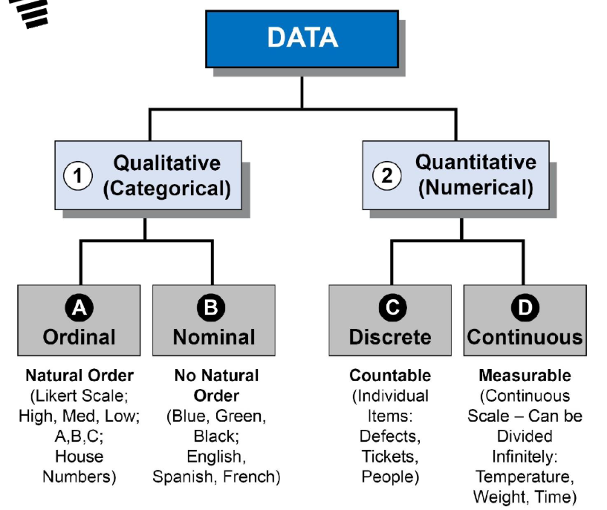
Types of data

Slide 25
Continuous data
Interval
Equal intervals between values
No true zero (zero does not mean none)
Addition and subtraction are meaningful
E.g. Date, temperature, time
Ratio
Like interval data but has true zero
Addition, subtraction, multiplication and division are meaningful.
E.g. Speed, distance

Slide 26
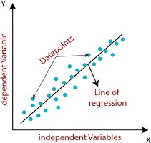
Linear Regression
Linear regression is used for modeling the relationship between a dependent variable (target) and one or more independent variables (predictors or features) by fitting a linear line to the observed data.
The aim is to find the best fitting line that describes the relationship.
Types
Simple Linear Regression
Multiple Linear Regression
Fig. Simple Linear
Regression

Slide 27
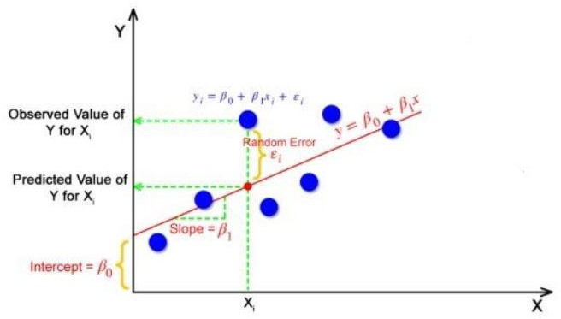
Simple Linear Regression
One independent and one dependent variable.
Simple Linear regression model is represented
by the following equation: -
𝑌 = 𝛽₀ + 𝛽₁𝑋
𝛽₀ – y intercept, 𝛽₁ − 𝑠𝑙𝑜𝑝𝑒
X – independent variable
Y – dependent variable
The slope and the intercept of the best fitting line determines the relationship between the variables.
where,
Fig. Simple Linear Regression

Slide 28
Simple Linear Regression: How is the best fitting line found?
Y
Y
Y
X
X
X
Trial 1: 𝑌 = 𝛽₀₁ + 𝛽₁₁𝑋
Trial 2: 𝑌 = 𝛽₀₂ + 𝛽₁₂𝑋
Trial 3: 𝑌 = 𝛽₀₃ + 𝛽₁₃𝑋
Y
Multiple trails of fitting a line are conducted, each time with a
different line
Error between the actual and predicted value is computed. The line with the least error is the best fitting line.
Trial 4: 𝑌 = 𝛽₀₃ + 𝛽₁₃𝑋
X

Slide 29
Simple Linear Regression: Residual Sum of Squares
Residual = y_{i} – y_{i}’,
where, y_{i} = actual value, y_{i}’ = predicted value
Mean Squared Error (MSE) = ¹ Σ (y – y ’)²
𝑛
i i
=
1
𝑛
Σ (y_{i} – (𝛽₀ + 𝛽₁𝑥_{𝑖}) )²
Fig. Simple Linear Regression
Link to video:
https://www.youtube.com/watch?v=owI7zxCqNY0Cab_channel=dataminingincae

Slide 30
Linear Regression: House Price Prediction
Area (sq. ft.) | Price (lakhs)
500 | 12
650 | 13.5
720 | 16.5
750 | 17
780 | 17.2
850 | 19
880 | 21
1050 | 24
1200 | 29
1550 | 41
Area (sq. ft.) | Price (lakhs)
500 | 12
650 | 13.5
720 | 16.5
750 | 17
780 | 17.2
850 | 19
880 | 21
1050 | 24
Training set is used for training (finding the best fit line).
80-20
split
Training set
Area (sq. ft.) | Price (lakhs)
1200 | 29
1550 | 41
Testing set is used for evaluating the trained model.
Data set
Testing set

Slide 31
Linear Regression: House Price Prediction (Training)
Area (sq. ft.) | Price (lakhs)
500 | 12
650 | 13.5
720 | 16.5
750 | 17
780 | 17.2
850 | 19
880 | 21
1050 | 24
PRICE VS. AREA
45
40
35
30
25
20
15
10
5
0
PRICE (LAKHS)
0
200
400
600
800 1000
AREA (SQ. FT.)
1200
1400
1600
1800
Training set
Best fitting line found by adjusting the slope (𝛽₁) and y intercept 𝛽₀ .
Suppose 𝛽₀ = 3 and 𝛽₁ = 6 are the determined values, then the equation of the best fitting line is 𝑌 = 3 + 6𝑋

Slide 32
Linear Regression: House Price Prediction (Testing)
Predicted
price
PRICE VS. AREA
Area (sq. ft.)
Price (lakhs)
45
1200
29
38 lakhs
40
35
1550
41
30
PRICE (LAKHS)
25
Testing set
20
Actual
price
15
10
𝒀 = 𝟎. 𝟐𝟒𝟐𝒙 + 𝟎. 𝟓𝟏
5
0
800 1000
AREA (SQ. FT.)
1400 1600
1550 sq. ft.
0
200
400
600
1200
1800
Price for the examples in the testing set predicted using the regression line.

Slide 33
Linear Regression: House Price Prediction
Prediction phase
Area (sq. ft.) | Price (lakhs)
500 | 12
650 | 13.5
720 | 16.5
750 | 17
780 | 17.2
850 | 19
880 | 21
1050 | 24
1200 | 29
1550 | 41
PRICE VS. AREA
45
40
35
30
25
20
15
10
5
0
PRICE (LAKHS)
0
200
400
600
800 1000
AREA (SQ. FT.)
1200
1400
1600
1800
Price of a house with area of 900 sq. ft.?
Data set

Slide 34
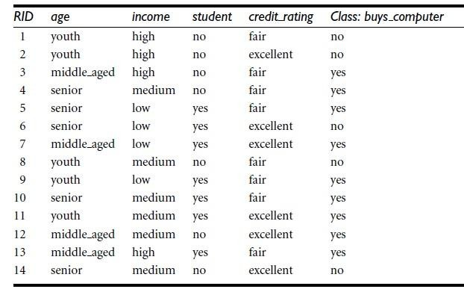
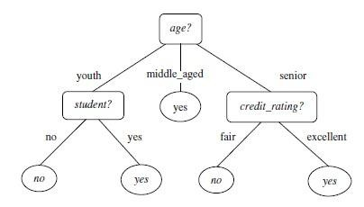
Decision Tree
A Decision Tree is a supervised learning algorithm used for both classification and regression tasks.
It works by splitting the data into subsets based on the most significant feature, creating a tree structure where each internal node represents a decision based on a feature, each branch represents the outcome of that decision, and each leaf node represents the final prediction.

Slide 35
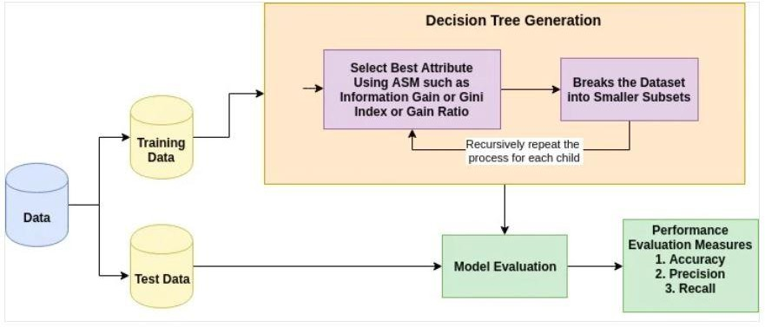
How does a Decision Tree work?

Slide 36
Training phase: Decision Tree Induction
Decision tree induction refers to the process of generating a decision tree from a given data set.
Select the Best Feature to Split:
Choose the feature that results in the largest gain in information.
Split the Dataset:
Divide the dataset into subsets based on the chosen feature and condition.
Repeat for Subsets
Apply the same process on each subset to create further decision nodes and
leaf nodes, until:
All data points are correctly classified.
A stopping criterion is met (e.g., maximum depth, minimum samples in a leaf).

Slide 37
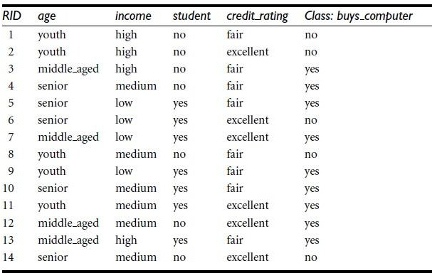
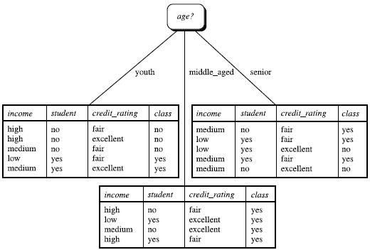
Training on the sample dataset
To generate a decision tree from the dataset, the following steps are followed: -
Select one of the features (age, income, student, credit_rating) to be placed at the root.
Based on the feature selected, create ‘x’ branches from the root, where x – number of unique values of the feature.
Follow the same process to place other features at the internal nodes.
Fig. Dataset
The leaf nodes will have the target classes.
Fig. Partially constructed decision tree with age as the root node

Slide 38
Training phase: Attribute selection measures
How was age selected to be placed at the root, out of the features (age, income, student, credit_rating)?
An attribute selection measure can be used to determine the best attribute.
Attribute selection measures that can be used: -
Information gain
Gain ratio
Gini index

Slide 39


Information Gain
Information gain is a metric that measures how much information is gained by splitting a data set on
a particular feature.
Information gain is calculated by comparing the entropy of the original dataset to the entropy of the child sets. A higher information gain indicates that the feature is more effective at splitting the data.
The entropy of the original dataset (D) is given as follows: -
where, p_{i} – probability that that a tuple in D belongs to class C
The entropy of the child set is given as follows: -
where, |D_{j}| – number of samples in subset j
|D| - total number of samples in the dataset
Info(D_{j}) – entropy of subset D_{j}
The information gain is given as follows: -

Slide 40




Information gain calculation
buys_computer: yes
buys_computer: no
Entropy of dataset
Entropy of the child set created when split on the attribute age
age: youth
age: middle_aged
age: senior
Information gain

Slide 41
Information gain calculation
The gain for the other attributes are Gain(income) = 0.029 bits
Gain(student) = 0.151 bits Gain(credit_ rating) = 0.048 bits
Since, age has the highest gain value, it is selected to be placed at the root.
The data is split as shown in the figure. The tuples for the partition middle_aged belong to the same category (class: yes), a pure partition. Hence a leaf node is created.
For the other two impure partitions (youth, senior), the same procedure is followed on the
remaining features (income, student, credit_rating).

Slide 42
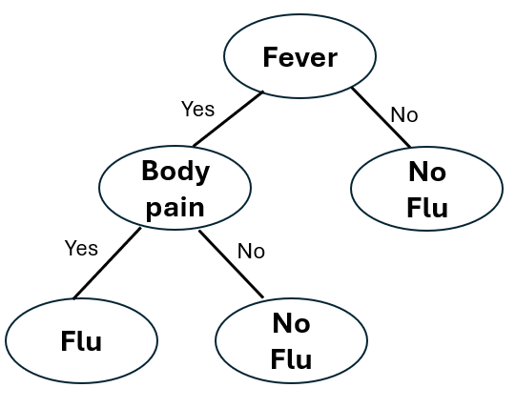
Flu prediction - Decision Tree
To predict whether a person has Flu based on basic symptoms.
Root node
Fever | Cough | Body Pain | Flu
Yes | Yes | Yes | Yes
Yes | No | Yes | Yes
No | Yes | No | No
No | No | No | No
Yes | Yes | No | No
No | Yes | Yes | No
Internal node
Leaf node
Dataset
Decision Tree

Slide 43
Decision Tree Induction (Training)
Determine which feature {Fever, cough, Body pain} is to be placed at the root.
How?
Choose each feature and check how well the target classes get separated.
Select the best feature as the root.
Fever | Cough | Body Pain | Flu
Yes | Yes | Yes | Yes
Yes | No | Yes | Yes
No | Yes | No | No
No | No | No | No
Yes | Yes | No | No
No | Yes | Yes | No

Slide 44
Decision Tree Induction (Training)
Upon determining the root, the dataset is divided into subsets.
Fever
Yes
No
Fever | Cough | Body Pain | Flu
Yes | Yes | Yes | Yes
Yes | No | Yes | Yes
No | Yes | No | No
No | No | No | No
Yes | Yes | No | No
No | Yes | Yes | No
Cough | Body Pain | Flu
Yes | Yes | Yes
No | Yes | Yes
Yes | No | No
Cough | Body Pain | Flu
Yes | No | No
No | No | No
Yes | Yes | No
Impure partition as target classes are not same
Pure partition as target classes are same
Repeat the process for the impure partition.

Slide 45
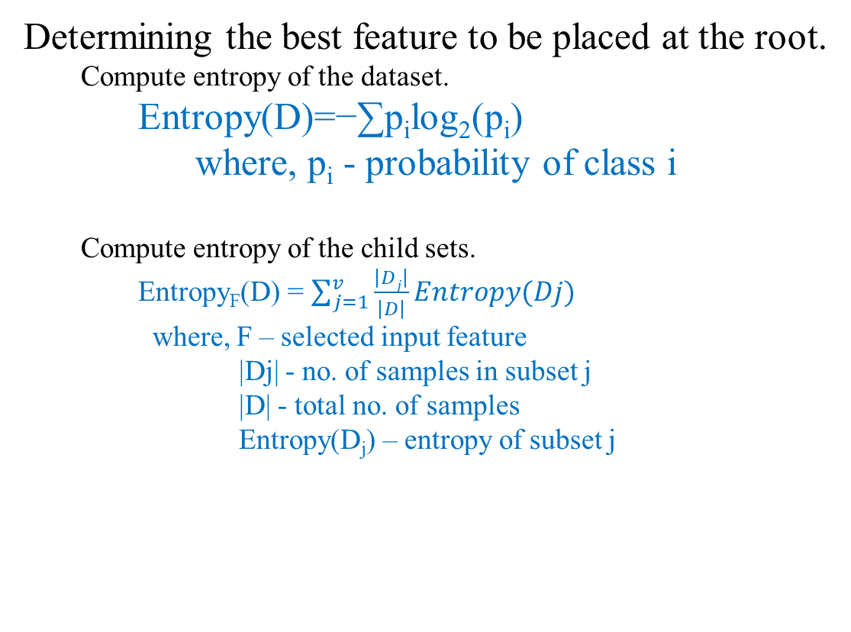
Decision Tree Induction (Training)
Determining the best feature to be placed at the root.
Compute entropy of the dataset.
Entropy(D)=−∑p_{i}​log₂​(p_{i}​)
where, p_{i}​ - probability of class i
Compute entropy of the child sets.
Entropy_{F}(D) = $\sum_{j=1}^{v}{\frac{\left|Dj\right|}{\left|D\right|}Entropy(Dj)}$
where, F – selected input feature
|Dj| - no. of samples in subset j
|D| - total no. of samples
Entropy(D_{j}) – entropy of subset j
Fever | Cough | Body Pain | Flu
Yes | Yes | Yes | Yes
Yes | No | Yes | Yes
No | Yes | No | No
No | No | No | No
Yes | Yes | No | No
No | Yes | Yes | No

Slide 46

Decision Tree Induction (Training)
Determining the best feature to be placed at the root.
Compute entropy of the dataset.
Entropy(D)=−∑p_{i}​log₂​(p_{i}​)
where, p_{i}​ - probability of class I
Entropy(D) = -$\left[\frac{2}{6}log\frac{2}{6}+ \frac{4}{6} log\frac{4}{6} \right]$ = 0.918
Fever | Cough | Body Pain | Flu
Yes | Yes | Yes | Yes
Yes | No | Yes | Yes
No | Yes | No | No
No | No | No | No
Yes | Yes | No | No
No | Yes | Yes | No
Flu = Yes
Flu = No

Slide 47
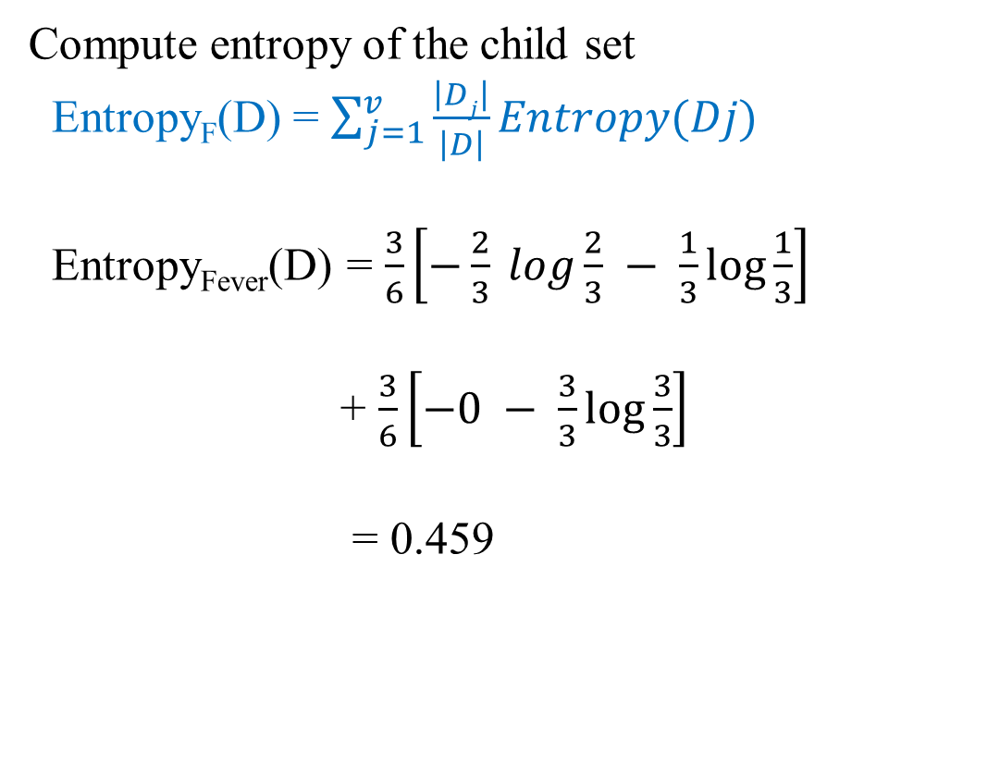
Decision Tree Induction (Training)
Fever | Cough | Body Pain | Flu
Yes | Yes | Yes | Yes
Yes | No | Yes | Yes
No | Yes | No | No
No | No | No | No
Yes | Yes | No | No
No | Yes | Yes | No
Compute entropy of the child set
Entropy_{F}(D) = $\sum_{j=1}^{v}{\frac{\left|Dj\right|}{\left|D\right|}Entropy(Dj)}$
Entropy_{Fever}(D) = $\frac{3}{6}\left[−\frac{2}{3} log\frac{2}{3} − \frac{1}{3}\log{\frac{1}{3}}\right]$
+ $\frac{3}{6}\left[−0 − \frac{3}{3}\log{\frac{3}{3}}\right]$
= 0.459
Flu = Yes
Flu = No
Fever = Yes
Fever = No
Flu = Yes
Flu = No
Cough | Body Pain | Flu
Yes | Yes | Yes
No | Yes | Yes
Yes | No | No
Cough | Body Pain | Flu
Yes | No | No
No | No | No
Yes | Yes | No

Slide 48
Decision Tree Induction (Training)
Fever | Cough | Body Pain | Flu
Yes | Yes | Yes | Yes
Yes | No | Yes | Yes
No | Yes | No | No
No | No | No | No
Yes | Yes | No | No
No | Yes | Yes | No
Compute information gain
Info. Gain (Fever) = Entropy(D) - Entropy_{Fever}(D)
= 0.459
Info. Gain (Cough) = Entropy(D) - Entropy_{Fever}(D)
= 0.044
Info. Gain (Body Pain) = Entropy(D) - Entropy_{Fever}(D)
= 0.458
Choose the feature with the highest Info. Gain as the root.

Slide 49
Spam Email Classification - Demo

Slide 50
Step1: Importing the libraries
import pandas as pd
from sklearn.feature_extraction.text import CountVectorizer
from sklearn.model_selection import train_test_split
from sklearn.tree import DecisionTreeClassifier
from sklearn.metrics import accuracy_score, confusion_matrix, classification_report
from sklearn.tree import plot_tree
import matplotlib.pyplot as plt

Slide 51
Step 1: Dataset Preparation
A labeled dataset of email messages is prepared.
Each message is tagged as spam or ham (normal email).
The dataset contains two columns
text → email content
label → class (spam / ham)
The dataset is imported into a pandas dataframe (df).
Email | label
Hi we will meet tomorrow at the office | ham
Congratulations you have won a free iPhone click now | spam
Please find the attached assignment for today | ham
Limited time offer buy one get one free | spam

Slide 52
Step 2: Data preprocessing (Label Encoding)
Textual labels are represented using numbers.
ham → 0
spam → 1
df["label"] = df["label"].map({"ham": 0, "spam": 1})
Email | label
Hi we will meet tomorrow at the office | 0
Congratulations you have won a free iPhone click now | 1
Please find the attached assignment for today | 0
Limited time offer buy one get one free | 1

Slide 53
Step 3: Text Feature Extraction (Bag of Words)
Technique Used: CountVectorizer
It is a feature extraction technique that converts textual data into numerical form by counting how often words appear in a document.
Step 1: Tokenization of the email text into words
Example: “Win a free prize” [“Win”, “a”, “free”, “prize”]
Step 2: Removal of common English stop-words (is, am, are, the, a, an, in)
[“Win”, “a”, “free”, “prize”] [“Win”, “free”, “prize” ]
Tokenization

Slide 54
Step 3: Text Feature Extraction (Bag of Words)
Step 3: Building a vocabulary of unique words
Collect all unique words and assign each word a feature index
Example
Email 1: "free win prize“
Email 2: "meeting tomorrow“
Feature vector: ["free", "win", "prize", “meeting", "tomorrow"]
Convert each email into a word-count vector
Email | free | win | prize | meeting | tomorrow
"free win prize" | 1 | 1 | 1 | 0 | 0
"meeting tomorrow" | 0 | 0 | 0 | 1 | 1
Bag of Words representation, word order does not matter, frequency matters

Slide 55
Step 4: Feature Matrix and Target Vector Formation
Dataset is represented as (X, Y)
Feature Matrix (X)
Target Label (Y): y – {ham , spam} → {0, 1}
Index | free | win | prize | meeting | tomorrow
0 | 1 | 1 | 1 | 0 | 0
1 | 0 | 0 | 0 | 1 | 1
Index | free | win | prize | meeting | tomorrow | Label
0 | 1 | 1 | 1 | 0 | 0 | 1
1 | 0 | 0 | 0 | 1 | 1 | 0

Slide 56
Steps 3 and 4
vectorizer = CountVectorizer(stop_words="english")
X = vectorizer.fit_transform(df["text"])
y = df["label"]

Slide 57
Step 5: Train–Test Split
Dataset is divided into training set and testing set.
X_train, X_test, y_train, y_test = train_test_split(
X, y, test_size=0.25, random_state=42
)
Step 6: Decision Tree is trained
dt = DecisionTreeClassifier(
criterion="entropy", # uses Information Gain
max_depth=5, # prevents overfitting
random_state=42
)
dt.fit(X_train, y_train)

Slide 58
Step 6: Decision Tree is tested
y_pred = dt.predict(X_test)
Step 9: Prediction done using the decision tree
sample = ["You have won a free cash prize"]
Output - spam

Slide 59
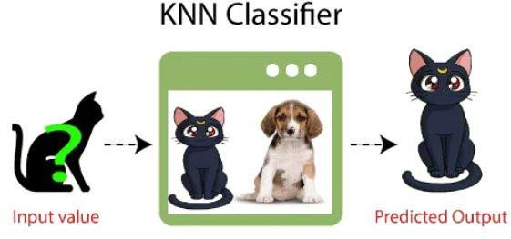
K Nearest Neighbor (KNN)
The K Nearest Neighbor (KNN) is an algorithm that can be used for both classification and regression (mostly used for classification).
It relies on the idea that similar data points tend to have similar labels or values.
Training phase: stores the entire dataset (lazy learner)
Testing phase: calculates distance between input data point to all the training examples using a distance metric (E.g. Euclidean dist., Manhattan dist., etc.)
Parameter tuning: value of ‘k’ determined.
Classify input value using the value of ‘k’.

Slide 60
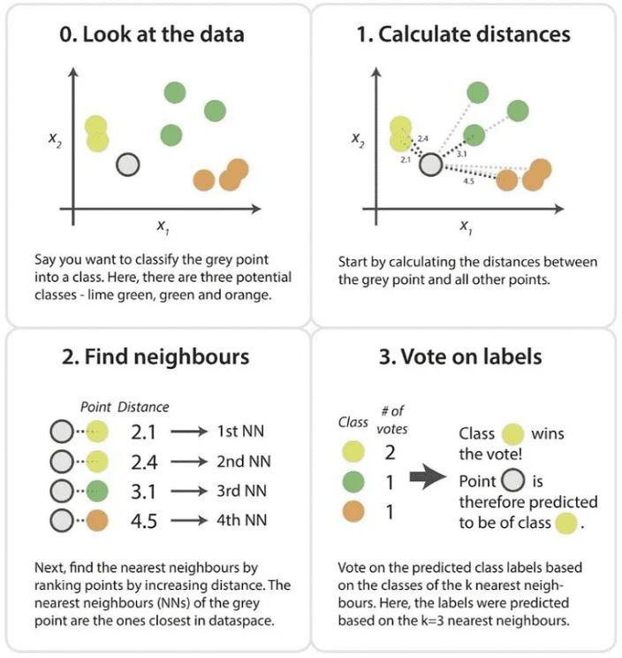
KNN
Choose K → the number of
neighbours to consider.
Compute distances → for a new input, calculate its distance (e.g., Euclidean, Manhattan) to all training samples.
Find the K nearest neighbors → pick the K training points closest to the input.
Make a decision → assign the most frequent class among the K neighbors.

Slide 61
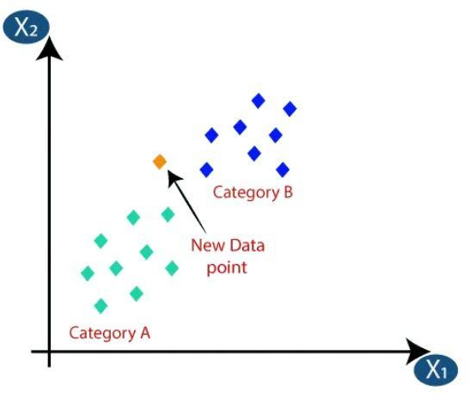
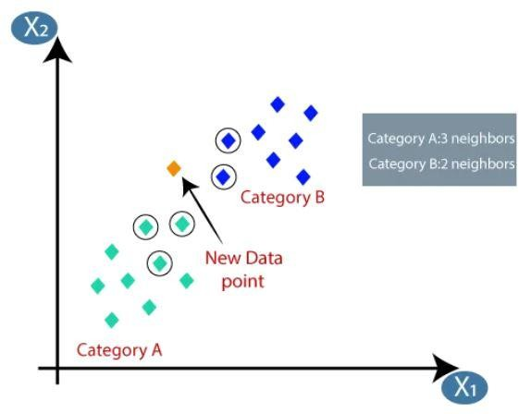
KNN - Example
There are two categories A and B, and we have a
new data point to classify.
Let K = 5
Calculate distance (Euclidean distance) of new data point to all data points.
2 ₊
Distance of new data point to every data point calculated.
Dist(p₁, p₂) = 𝑥₂ − 𝑥₁ 𝑦₂ − 𝑦₁
2
Take K nearest neighbors as per the calculated distance.
Nearest neighbors in category A = 3
Nearest neighbors in category B = 2
The new data point is assigned to category A
K nearest neighbours encircled

Slide 62
Determining value of ‘K’
The selection of the optimal ‘k’ value depends on the specific dataset and the characteristics of the problem, and it can significantly impact the performance of the algorithm.
Considerations
Odd value of ‘k’ more suitable.
Smaller value of ‘k’ can be noisy, while larger can
computationally expensive.
Cross validation
K = sqrt(N), where N = no. of samples in the dataset.
have bias and is more

Slide 63
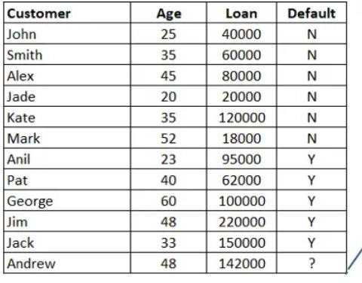
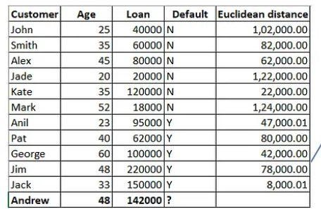
Example: Determine the ‘Default’ status for Andrew.
Training
data
Step 1: Calculate the distance to all data
points

Slide 64
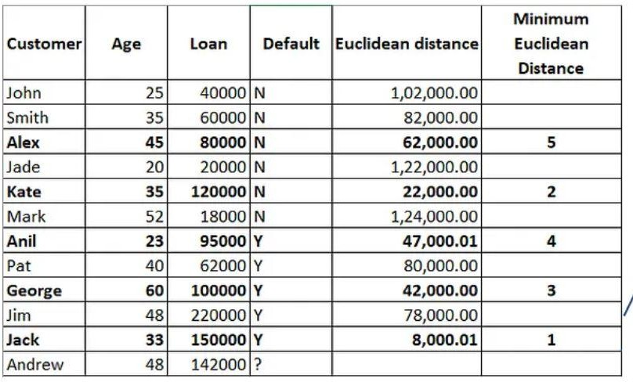
Example: Determine the ‘Default’ status for Andrew.
Step 2: Assume k = 5
Step 3: Find five minimum distance values.
Out of 5 chosen records there are three Ys and two Ns.
Andrew’s default status is taken as Y.

